Slide 1
Cardiovascular Risk Factor
Team 13

Slide 2
Table of contents
01
02
Introduction
Data Preprocessing
03
04
Descriptive Statistics
Statistical Tests

Slide 3
Table of contents
05
06
Conditional Distributions
Naïve Bayes Classifier
07
Comparison with Standard Python Packages

Slide 4
01
Introduction

Slide 5
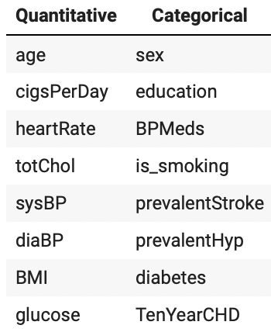
Introduction
Our study
The benefits of early detection of Cardiovascular disease
Early Intervention
Improved Treatment Outcomes
A brief on the dataset and their classification
Features and the target label

Slide 6
02
Data Preprocessing

Slide 7
Data Loading
Dataset is imported using Pandas library.
Pandas provides efficient data manipulation and analysis capabilities.
Utilized "label encoding" technique for categorical variables that transforms categories into numerical representations.
Label encoding enables effective processing of categorical data by machine learning algorithms.
'sex' feature: 'male (M)' encoded as 1 and 'female (F)' encoded as 0.
'is_smoking' column: 'YES' encoded as 1 and 'NO' encoded as 0.

Slide 8
Outlier Removal and Detection
Ensuring robustness of the analysis and increases dataset reliability and accuracy with improved data quality.
Identified outliers using the Interquartile Range (IQR) method which is a robust statistical measure for outlier detection.
Removed outliers from selected numeric columns, excluding specific categorical features and the 'id' column.
IQR threshold is defined to identify outliers.
The categorical features were excluded from the outlier removal process as they only have specific values (binary values) making it insensible to remove any data from them.

Slide 9
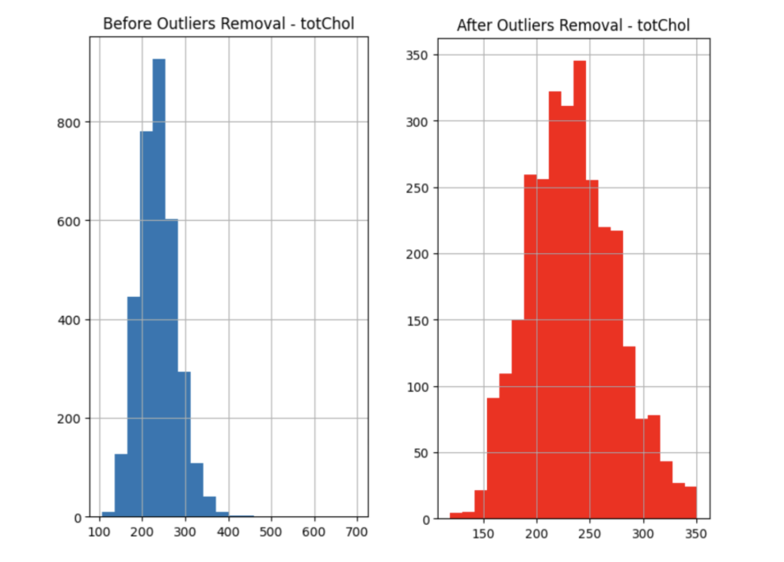
Displaying before and after effects of removing outliers from the dataset

Slide 10
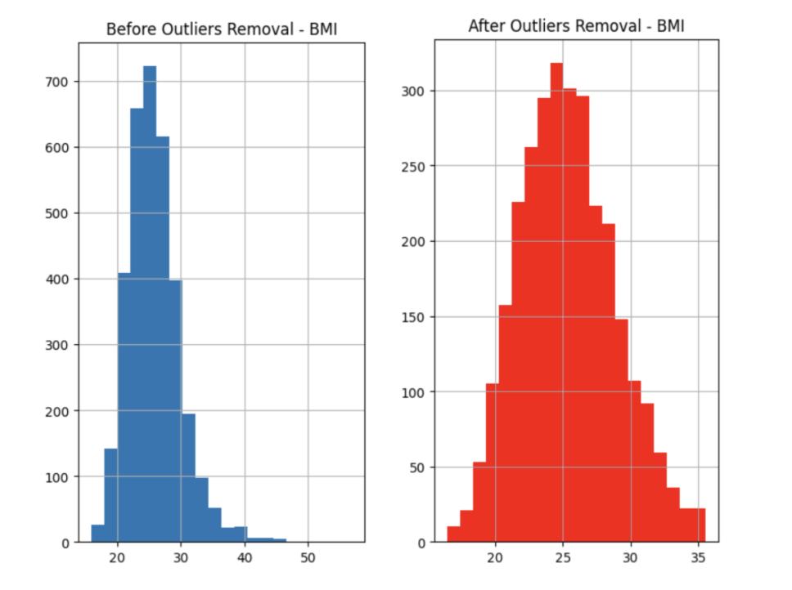
Displaying before and after effects of removing outliers from the dataset

Slide 11
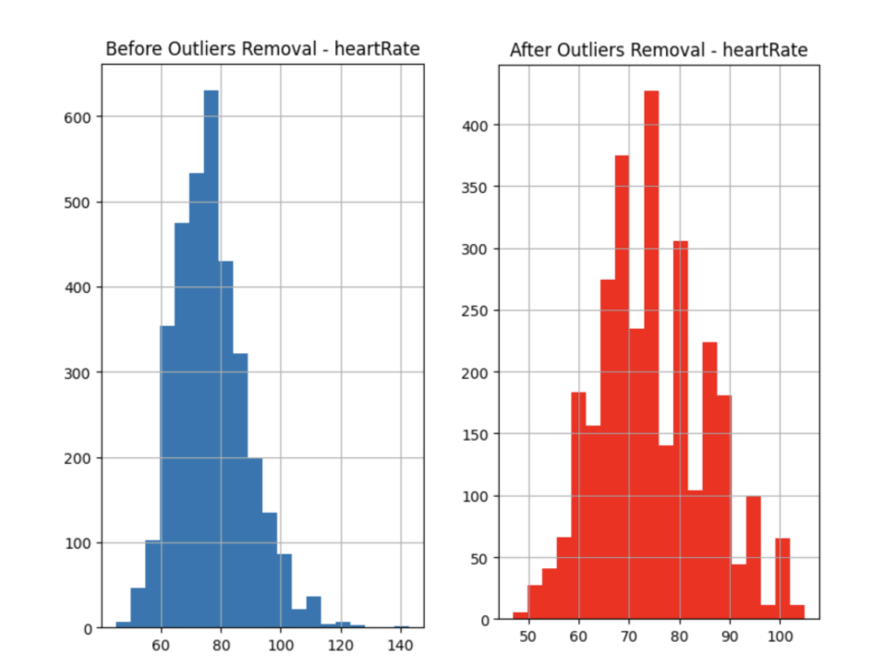
Displaying before and after effects of removing outliers from the dataset

Slide 12
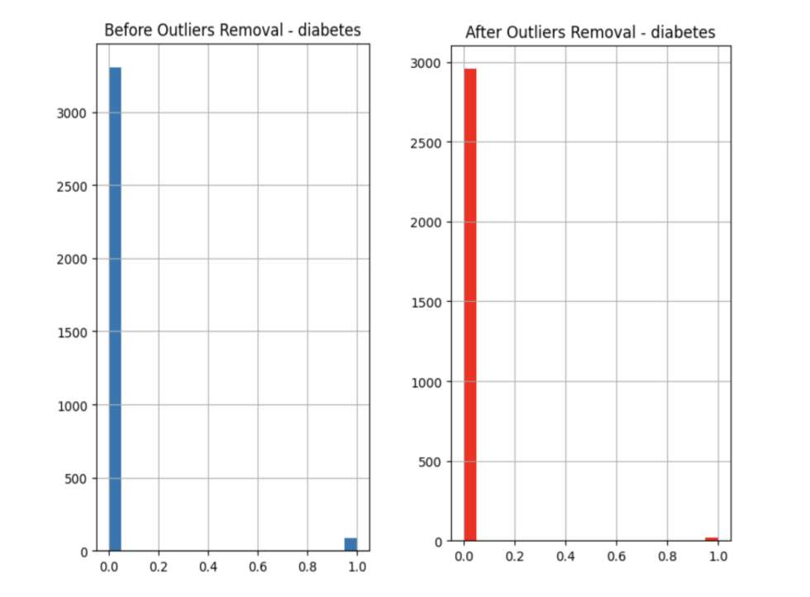
Displaying before and after effects of removing outliers from the dataset

Slide 13
Displaying before and after effects of removing outliers from the dataset
Important Note: Categorical features, as we mentioned, did not participate in the removal process, however, due to removal of outliers from the quantitative columns, the whole row of data is deleted and this surely affects the count of categorical rows.

Slide 14
Handling Missing Values
We need to address the missing values in the dataset to:
- Preventing biased or misleading analysis
- Maintaining statistical power and accuracy
- Enhancing the reliability of results
Imputation strategy is applied to fill missing values
Missing values are replaced with the mean value of each respective column
Imputation preserves sample size and statistical power and reduces potential bias caused by missing data

Slide 15
03
The Descriptive Statistics

Slide 16
Quantitative features
 | age | cigsPerDay | totChol | sysBP | diaBP | BMI | heartRate | glucose
Mode | 40.00 | 0.00 | 240.00 | 120.00 | 80.00 | 22.91 | 75.00 | 75.00
Mean | 49.057479 | 9.133581 | 234.367097 | 129.327227 | 81.517311 | 25.389858 | 74.891056 | 78.313682
Median | 48.00 | 1.00 | 232.00 | 127.00 | 81.00 | 25.14 | 75.00 | 77.00
Standard deviation | 8.495008 | 11.645535 | 40.988083 | 18.265915 | 10.540621 | 3.513721 | 10.771652 | 11.014433
Range | 38.00 | 50.00 | 232.00 | 101.00 | 61.00 | 19.05 | 58.00 | 64.00
Minimum | 32.00 | 0.00 | 119.00 | 83.50 | 52.00 | 16.48 | 47.00 | 47.00
Maximum | 70.00 | 50.00 | 351.00 | 184.50 | 113.00 | 35.53 | 105.00 | 111.00
Count | 2975 | 2957 | 2942 | 2975 | 2975 | 2964 | 2974 | 2697

Slide 17
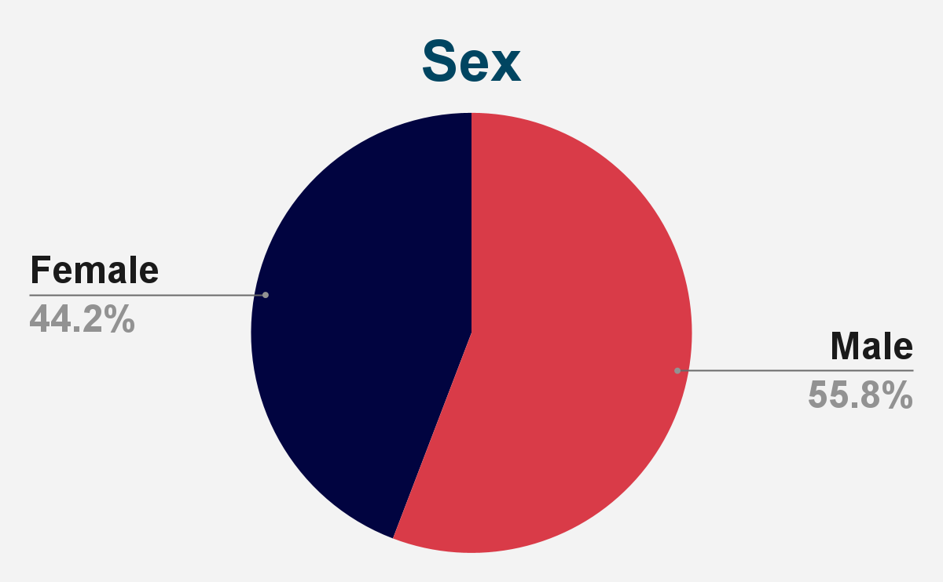
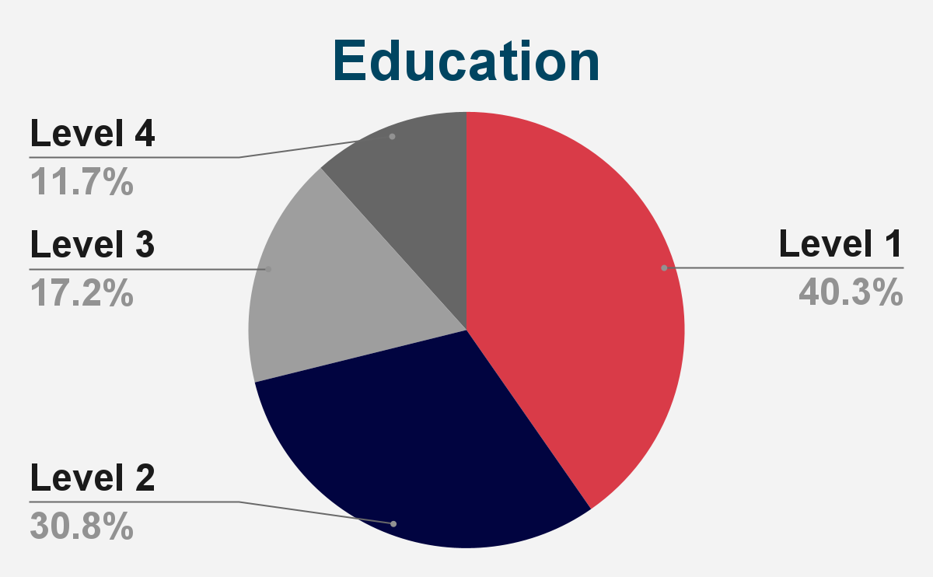
Categorical features
Mode: 0.00 Count: 2975
Mode: 1.00 Count: 2897

Slide 18
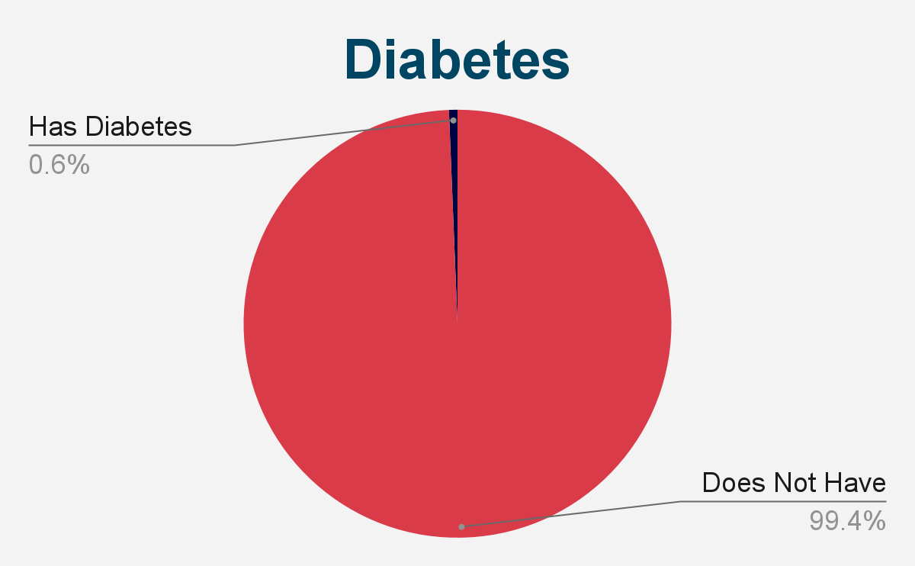
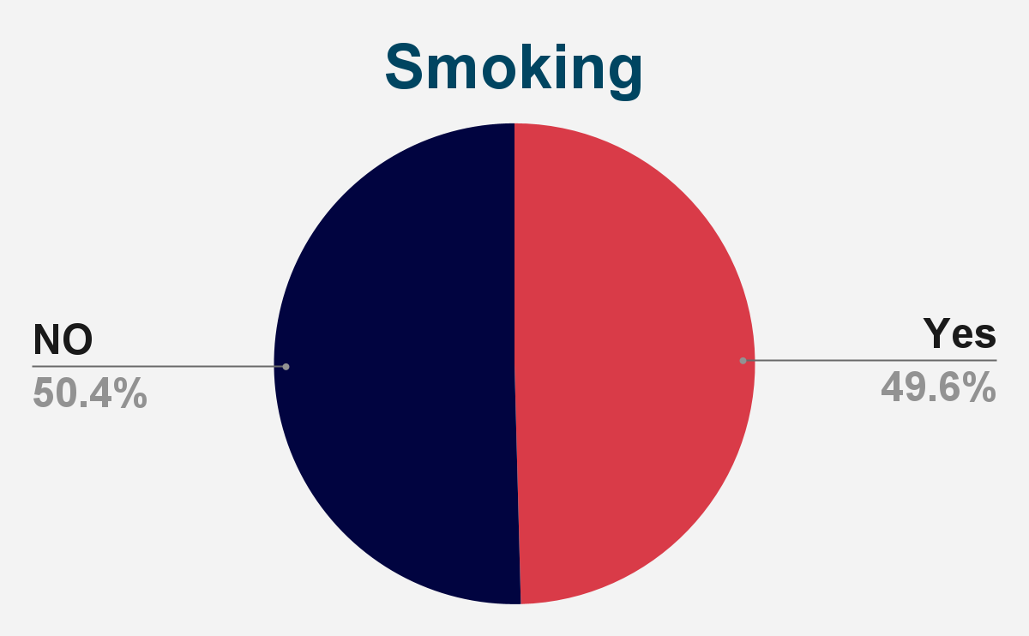
Categorical features
Mode: 0.00 Count: 2975
Mode: 1.00 Count: 2975

Slide 19
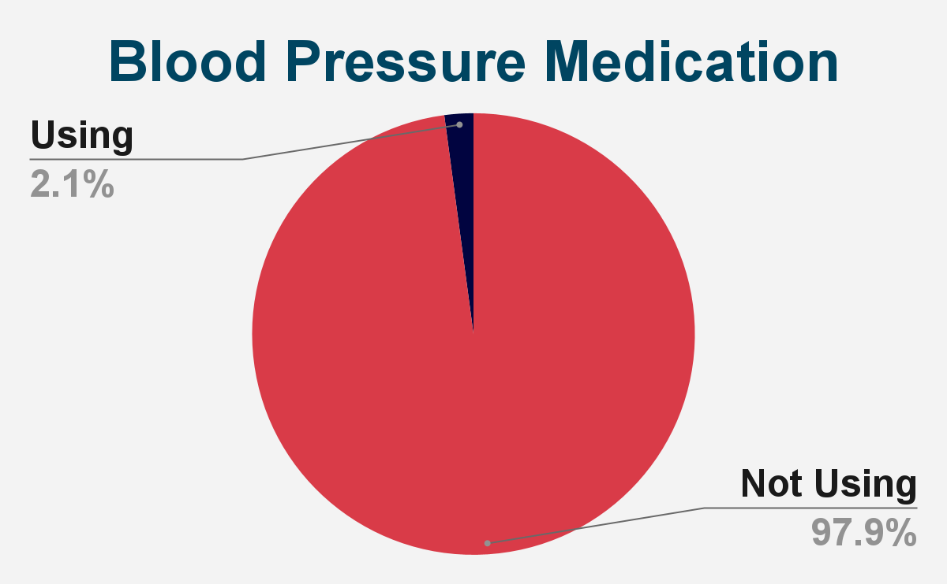
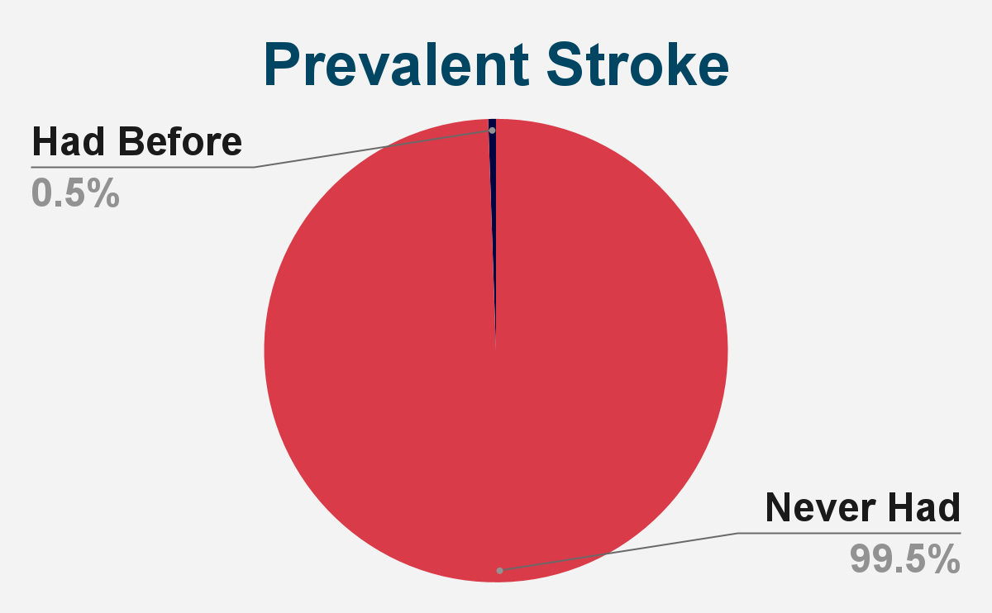
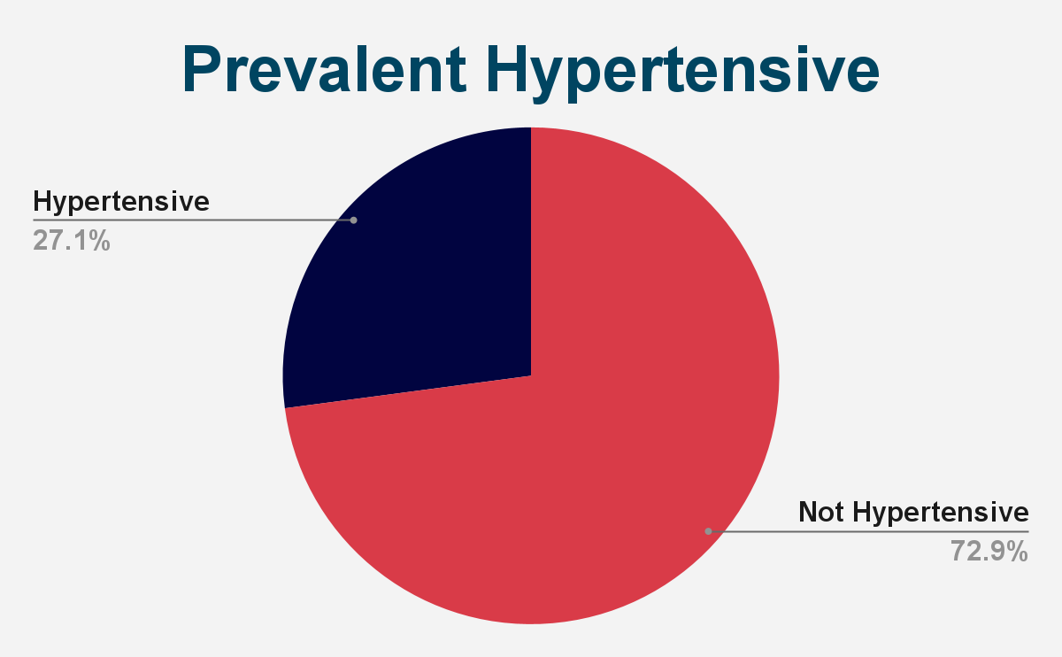
Categorical features
Mode: 0.00 Count: 2939
Mode: 0.00 Count: 2975
Mode: 0.00 Count: 2975

Slide 20
04
Statistical Tests

Slide 21
Normality Test For Quantitative Data
Null and Alternative hypotheses of Quantitative features using Shapiro-Wilk test:
Null hypothesis: The data is normally distributed.
Alternative hypothesis: The data is not normally distributed.
Interpreting the Shapiro-Wilk test result:
The p-value associated with the test statistic is compared to a chosen significance level (0.05).
If p-value > 0.05:
Fail to reject the null hypothesis (normally distributed)
If p-value <= 0.05:
Reject the null hypothesis (not normally distributed)

Slide 22
Association Test For Categorical Data
Null and Alternative hypotheses of Categorical features using Chi-square test:
Null hypothesis: There is no association between the categorical feature and the target variable.
Alternative hypothesis: There is an association between the categorical feature and the target variable.

Slide 23
Association Test For Categorical Data
Procedure:
Iterates over each categorical feature.
Creates a contingency table to calculate frequency counts.
Conducts the chi-square test on the contingency table.
Prints the results indicating the presence or absence of association.
Significance level:
A significance level of 0.05 is used to determine the presence of association.
If the p-value is less than or equal to 0.05, the null hypothesis is rejected, suggesting an association between the categorical feature and the target variable.

Slide 24
05
Conditional distributions

Slide 25
Conditional distributions
Conditional distributions of each feature on the target class (TenYearCHD) were analyzed and visualized.
The visual representations provided insights into the variations and patterns observed in the distributions of different features based on the two classes.
By examining these conditional distributions, we gained an understanding of the potential predictive power of specific features for assessing the risk of cardiovascular disease.
The visualizations helped identify features that exhibited distinct distribution patterns ,indicating their importance as potential indicators of cardiovascular disease risk.

Slide 26
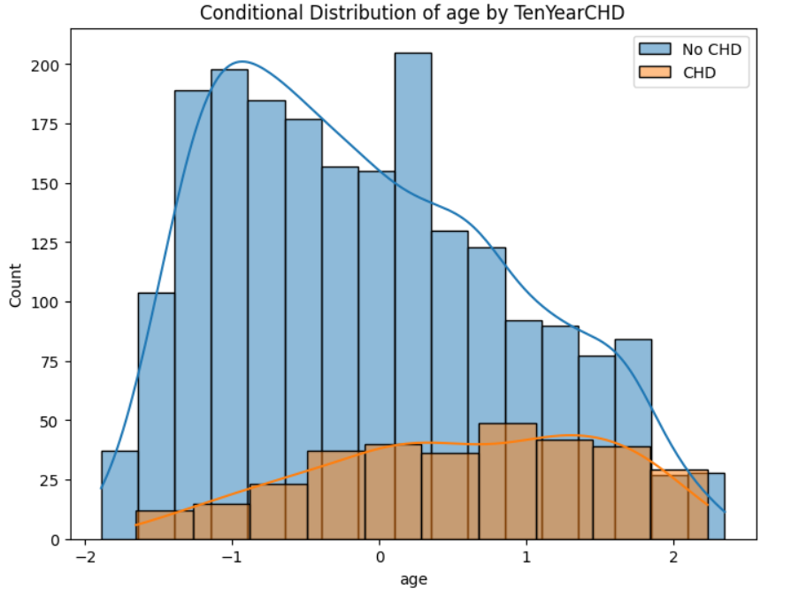
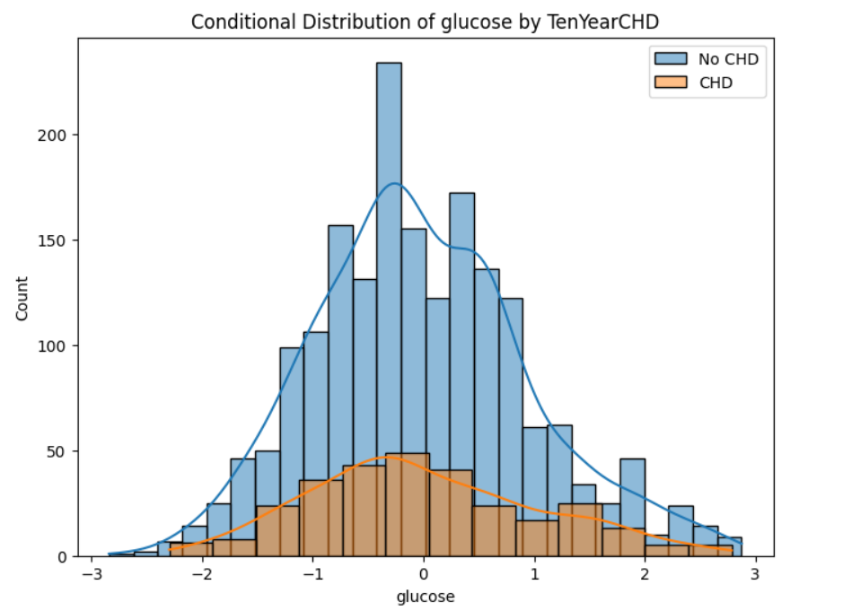
Conditional distributions
These visualizations serve as valuable tools for highlighting the relationship between features ‘age’ and ‘glucose’ and the likelihood of developing cardiovascular disease within ten years.

Slide 27
06
Naïve Bayes Classifier

Slide 28
Naïve Bayes Classifier
Concept of NB classifier
Steps taken to implement and train the classifier on the training data
Accuracy achieved by the Classifier on the testing data:

Slide 29
07
Comparison with Standard Python Packages

Slide 30
Comparison with Standard Python Packages
Comparison of the custom implementation with Standard Python Packages
Accuracy achieved by the standard NB Classifier on the testing data:

Slide 31
Team Members
Nourhan Ahmed
Ahmed Emad
Omar Nabil
Khaled Mohammed
Hazem Zakaria

Slide 32
Thank you!

